Slide 1

Multi-Agent Path Finding Implementation: Sliding Puzzle
By Brett Bala & Kirt Narain

Slide 2

Kirt Narain CS Major
Notes:
Kirt

Slide 3

Brett Bala CS Major

Slide 4
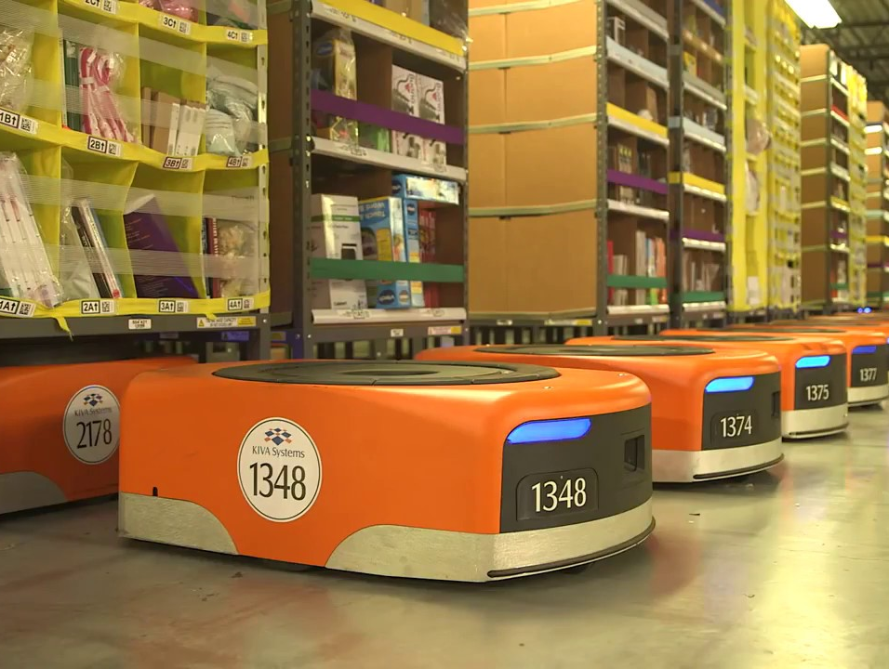
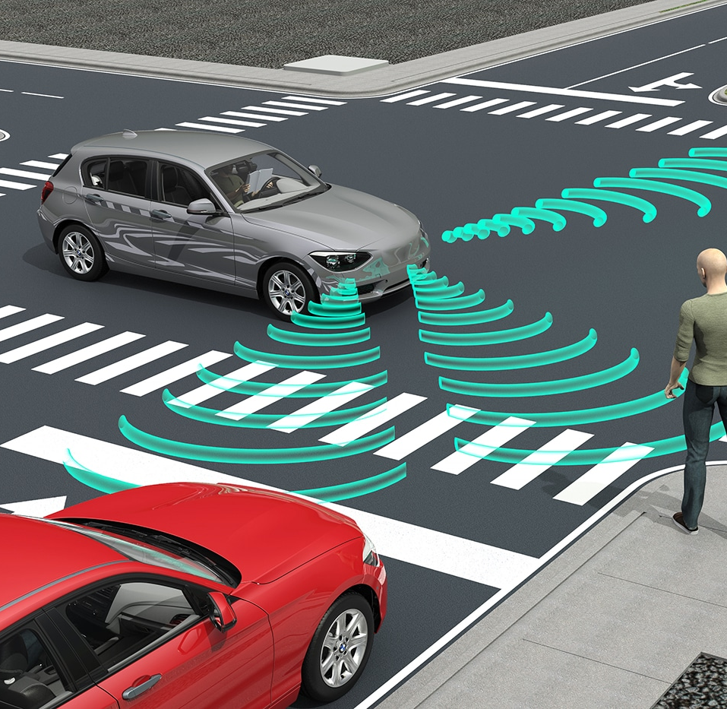
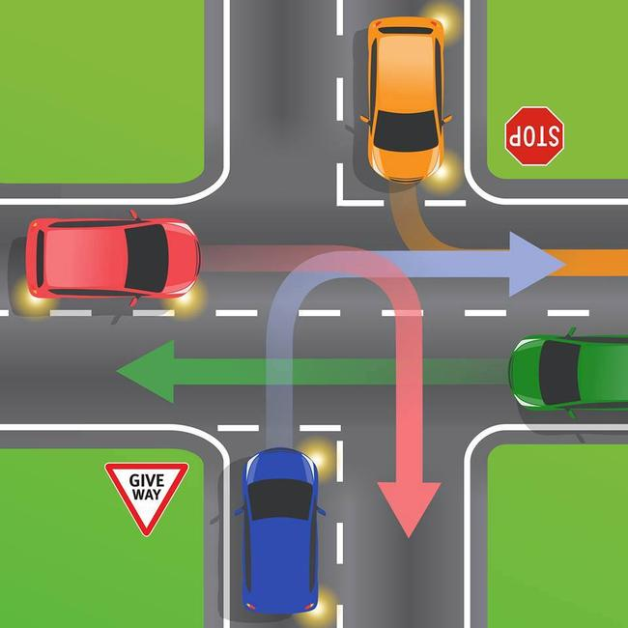
Last time, on Multi-Agent Path Finding
Multi-Agent Path Finding is a method of having n unique agents traverse a map to reach their destination
The agents cannot occupy the any space at the same time, and there are a number of conflicts that may need to be avoided
MAPF works as an extension of previous pathfinding algorithms, such as Dijkstra or A*.
Notes:
Brett

Slide 5
Evaluations of MAPF
Makespan: The number steps (or 'turns'), required for all agents to reach their target.
Sum of costs: The summation of each agent's makespan. Also known as 'flowtime'.
Notes:
Brett

Slide 6
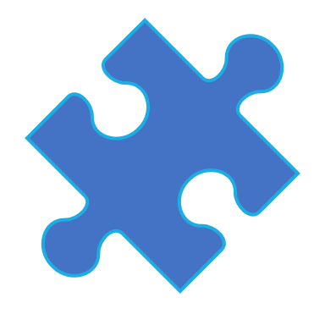
Our Implementation
Our implementation involved making a program that would both randomly generate and solve a 'sliding block puzzle' of n x n size.
Each individual piece of the block puzzle is considered a unique agent.
Our evaluation of the efficiency was a combination of the makespan of the board and the time it took to process the correct result.
Notes:
Brett
http://idm-lab.org/slides/mapf-tutorial.pdf slide #1

Slide 7
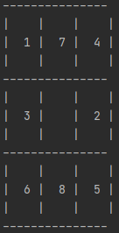
Structure of a Sliding Block Puzzle
When generating a sliding block puzzle, there are two ways to make sure it is solvable:
Start the board in a solved state, then make a large amount of 'legal' moves to generate a seemingly random board.
Start the board by randomly generating the order at the beginning. This can lead to unsolvable boards if the rules of inversions are not taken into consideration.
An inversion is when, to reach a solved state, two numbers will have to invert their positions. For example, the board on the right has an inversion count of 10.
Notes:
Brett

Slide 8
Rules of Inversions
Three factors determine whether a board is solvable or not
Whether the size (n) is odd or even
The number of inversions
The location of the blank
If n is odd: the number of inversions must be even
If n is even:
The blank is on an even row (counting from the bottom) and the number of inversions are odd
The blank is on an odd row, and the number of inversions is even
For any other cases, the puzzle is not solvable.

Slide 9

Solving the Sliding Puzzle
Notes:
Kirt

Slide 10
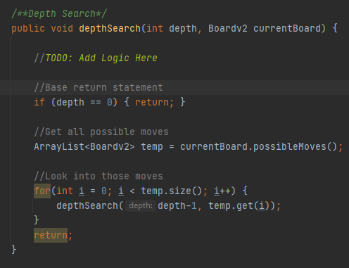
The First Thought Process
In order to see our different options for moves, we must create away to see future moves beyond just the next. A recursive depth search is a great way to accomplish this. The code shows how implementing a depth search with our given board state is quite simple. Just have a parameter for the depth and board, a base case, and calling depthSearch again on all possible board states/moves. The only thing missing is our analysis of the given boards

Slide 11
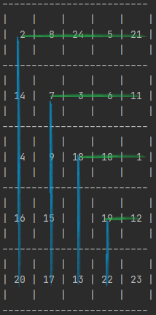
Divide and Conquer the Board
As the size of the board (n) increases, it takes exponentially longer to solve the board this way. To speed up the process, we implemented a divide and conquer strategy. This will allow the program to determine if the top row or most left column is complete, and then shrink the size of the board down if it is.
Notes:
Kirt
https://icaps20.icaps-conference.org/paper319.html

Slide 12
Improving Further
The depth search still takes a lot of time. So how else can we speed it up? We made functions to give the board a score based on how complete it is. The score is equivalent to the summation of how many moves each piece is away from the goal. The lower the score of the board, the closer it is to complete. By using these scores at the end of the depth searches, we can 'prune' away any boards with scores below a set threshold.
For example, the 4 piece must move to spaces to the left and one down to reach its target, giving it a score of 3.
Notes:
Kirt

Slide 13

Optimizing Searching
A big part of this is optimizing the depth search such that is can run at a reasonable time. With just a few simple tweaks to the AI we can achieve this.

Slide 14
Optimizing: Avoiding Repeat Moves
A very basic idea is to not repeat the last move
For example, if we moved Piece X last move, if we move Piece X again, it will result in a repeated board state.
To combat this, we can store the last move of a board and prevent that as a move.
This lowers our possible number of moves of 2 – 4 down to 1 - 3

Slide 15

Optimizing: More Frequent, Lower Depth Searches
Rather than using a depth of 30 to solve an entire row we can use the same method twice with a depth 15.
Remember, the method will return the best scoring board
If we assume on average, there are 2 possible moves for the board to make then:
A single depth search of 30: $2^{30}+ =1,073,741,824$ boards to analyze
Two depth searches of 15: $2^{15}+2^{15}=65,536$ boards to analyze
We searched 16,384 times less boards!

Slide 16
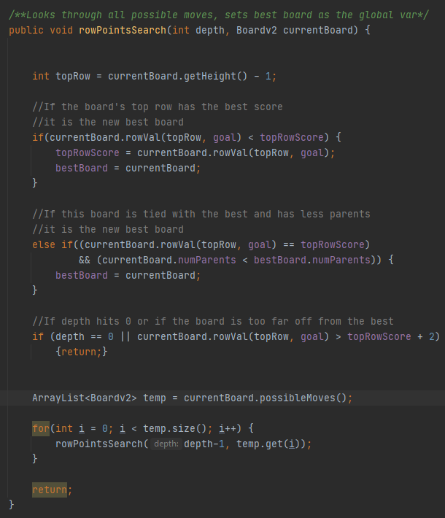
Optimizing: Finalizing Efficiencies
We can further prune potential moves. We knows sometimes the score must increase before it can decrease, but it only ever needs to increase a maximum of two in order to get a piece to its goal. That means we can prune any board that’s score is more than two compared to the best board
Remember, we are looking to have the smallest score possible and ideally a 0

Slide 17
More on Board Design
With the methodology put forward, sliding puzzles can now be solved. There are a few more tweaks implemented to ensure that the program can display these boards and work slightly better.

Slide 18
Board Design: Cloning
Java is a pain when it comes to making deep copies of objects, it only passes primitives by values, everything else is by address. That means you run the risk of clobbering existing boards.
To combat this, we had to create a cloning method to make a copy of the board from their primitives, so we can edit the new child board without affecting the parent.
This required some serious refactoring; we discuss it more in our paper.

Slide 19
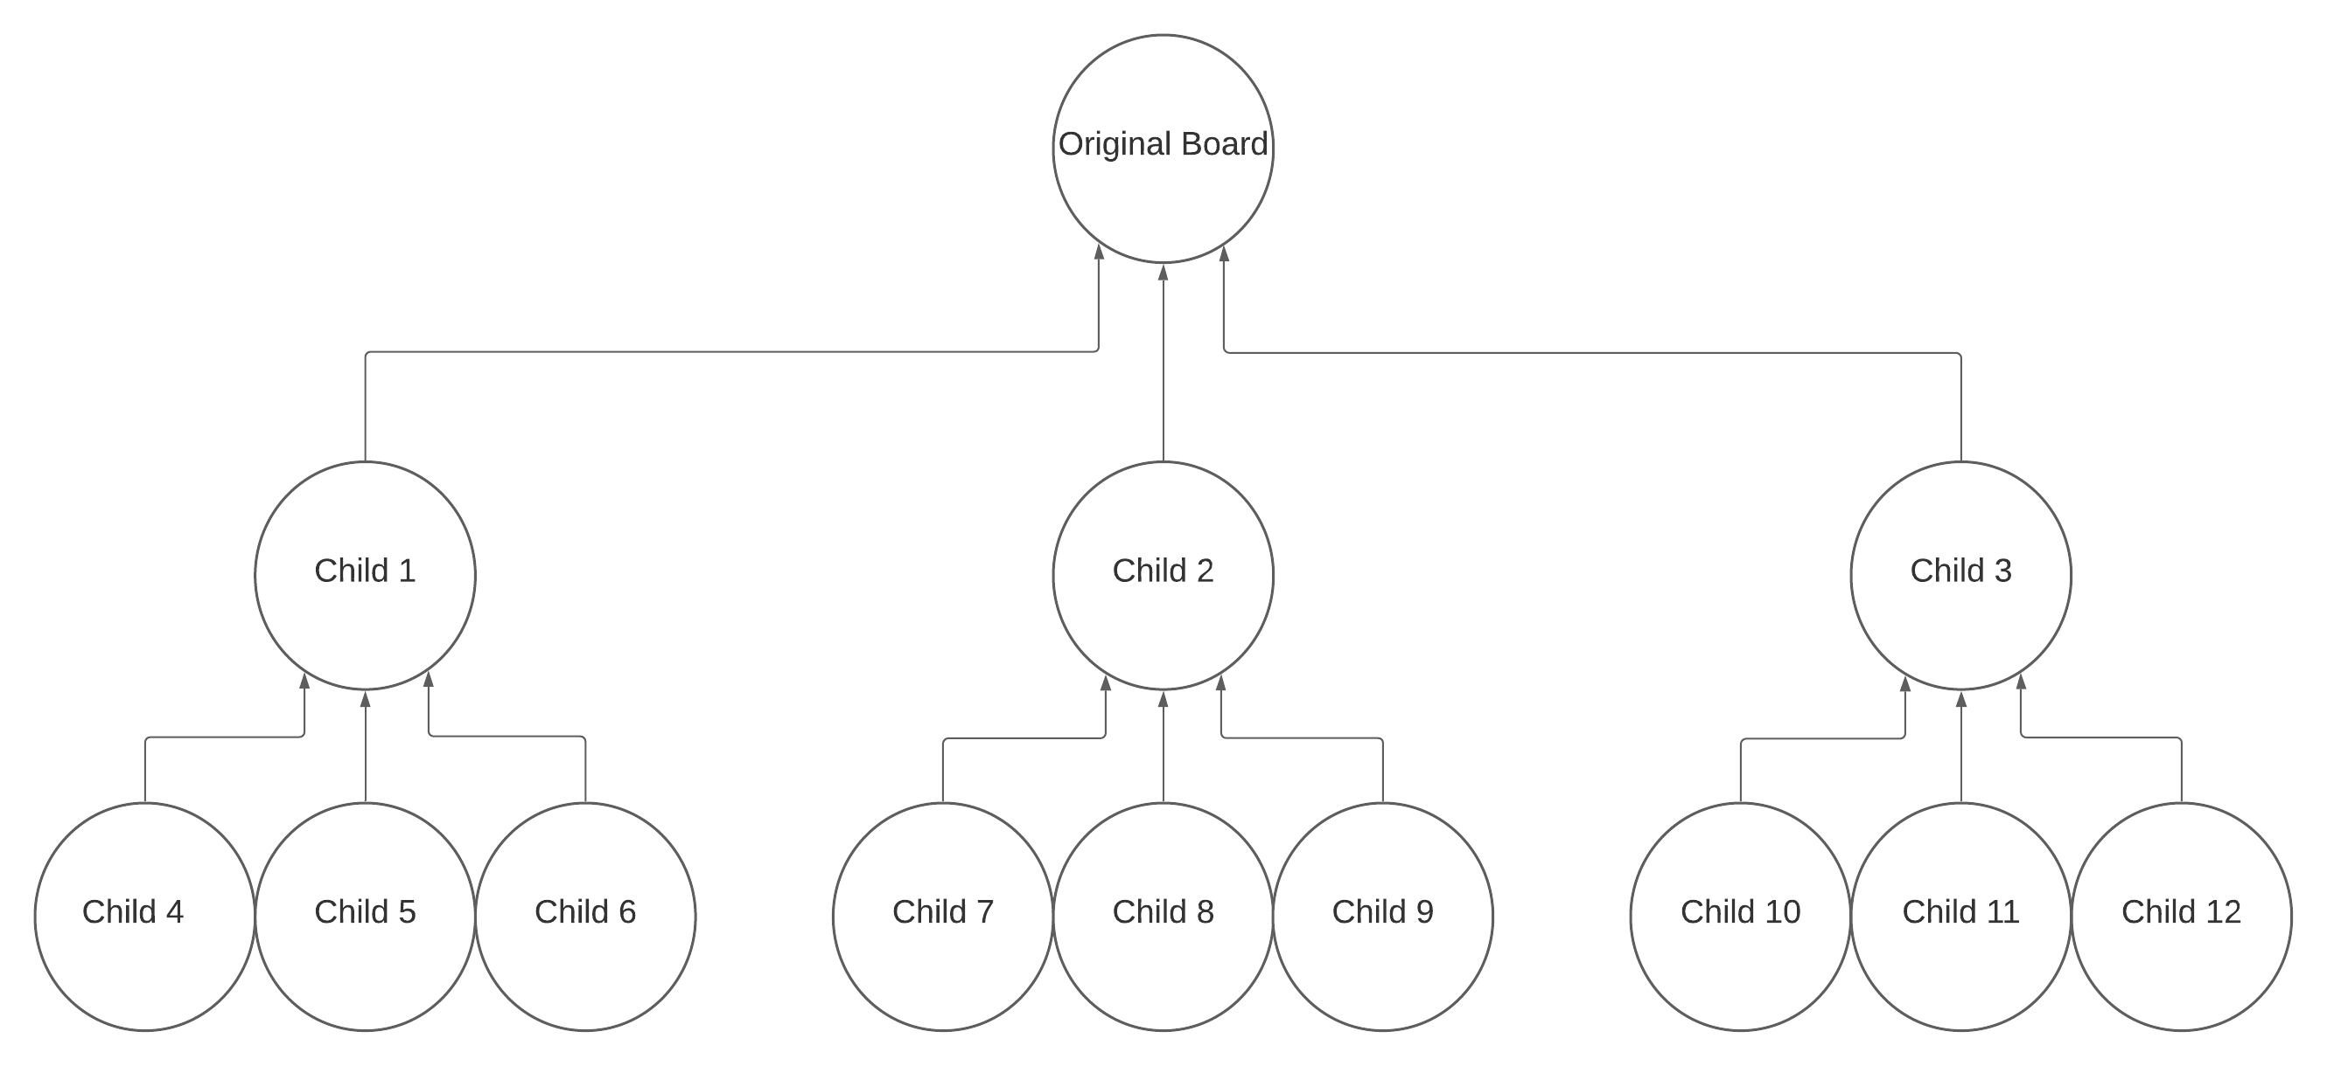
Board Design: Parent Boards
Each child board points to the parent board, this allows us to display all the moves prior to the existing move.
Each child also holds the number of parents it has. This allows us to tell how many moves it took to reach its current score. If two boards are tied in score for being the best board, the board with the least moves will get the crown

Slide 20
Difficulties and Potential Improvements
We certainly did face difficulties and challenges while creating this AI. It is the first time either group member has ever created a program with this style of depth search and pruning requirement. We also did not manage to finish and make the ability to trial two blanks. The group is aware of other improvements it can make.

Slide 21
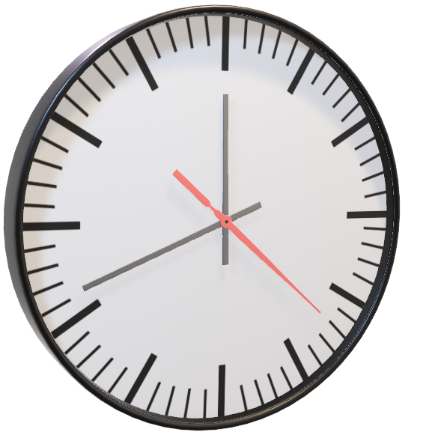
Time Constraints
Both members work near full-time along with being enrolled full-time for college.
Since the P-Talk there has been 3 weeks for us to code the AI and create all the write-ups
With more time, more things would have been ironed out

Slide 22
Code Inefficiency
There are certainly points where there are inefficiencies:
Using ArrayLists, which are known to run slowly.
Using a language like Java when speed is a priority, C would have been better
Needless loops that could be done linearly or faster
Etc
The choice of language was simply of preference and practice for the group members. Besides that, the inefficiencies are a result of the aforementioned time constraint. When a programmer’s time becomes valuable, they must take shortcuts to get the product done, even it is not as efficient is possible. We took our time for efficiency where it mattered most, like in pruning.

Slide 23

Two Blank Implementation
We are confident in being able to implement a two-blank version, however, time constraints as mentioned earlier defiantly became an issue.
Creating Two Blank would also require lots of refactoring
That being said, we know how we would tackle this challenge

Slide 24

Two Blanks: More Possibilities
With one blank: There are a maximum of 3 possible moves
With two blanks: There are a maximum of 17 possible moves
We would have to look with much less depth.
However, it takes even less moves to get to a solution, so that less depth may not end up mattering. It could take say 20 moves instead of 50.

Slide 25
Two Blanks: Better Pruning
With 2 blank spaces, we can prune even more aggressively.
Remember how we discard boards that are more than 2 + bestRowScore?
This is to give our AI flexible to move backwards in order to move forwards. A two blank version would need less flexibility since we’d have more movement control.
We can be more aggressive with our pruning and try to discard any board that is 1 + bestRowScore and maybe even try discarding everything greater than the bestRowScore
We wonder if this might end up being even faster than one blank with this ability.

Slide 26
Group Takeaways
Our first time making an AI of this complexity, and rather successfully
Our first time being very focused on performance and pruning
Moving forward, we will be more thoughtful on our computing time and what changes will affect it the greatest

Slide 27
References
R. Stern, N. Sturtevant, A. Felner, S. Koenig, H. Ma, T. Walker, J. Li, D. Atzmon, L. Cohen, T. K. S. Kumar, E. Boyarski, and R. Bartak, “Multi-Agent Pathfinding: Definitions, Variants, and Benchmarks,” arXiv.org, 19-Jun-2019. [Online]. Available: https://arxiv.org/abs/1906.08291. [Accessed: 02-Apr-2021].
N. Ayanian, T. Cai, and L. Cohen, “Multi-Agent Path Finding,” idm-lab. [Online]. Available: http://idm-lab.org/slides/mapf-tutorial.pdf. [Accessed: 02-Apr-2021].

Slide 28


Any Questions?
Notes:
Kirt/Brett

